Slide 1


Next Hikes IT Solutions Project 2: Data Harmonization & Insights Extraction
By- Avantika Verma

Slide 2


Table of Contents
Project Overview
Key Deliverables
Project Workflow
Dataset Overview
Tools and Techniques
Challenges Faced
Key Insights
Visualizations
Learning Outcomes

Slide 3
Project Overview
Objective:
The project aims to tackle the challenges posed by ambiguous and inconsistent data in multiple datasets. Specifically, the goals include:
Data Harmonization:
Address ambiguities and inconsistencies within the data.
Employ advanced data-wrangling techniques to standardize and unify datasets.
Data Exploration:
Analyze and understand the characteristics of the data.
Identify data quality issues, including missing values, irregular cardinality, and outliers.
Data Quality Improvement:
Detect and handle missing or null values using Python tools like isnull(), notnull(), dropna(), and fillna().
Prepare the data for seamless integration into future business analysis and predictive modeling processes.

Slide 4
Key Deliverables
Cleaned and Unified Dataset:
A consolidated dataset free from inconsistencies, ambiguities, and quality issues (e.g., missing values, outliers).
Data Quality Report:
Documentation detailing the data cleaning process, including handling missing values, outliers, and other quality improvements.
Exploratory Data Analysis (EDA) Insights:
Visualizations and summaries highlighting key patterns and trends in the data.
Ready-to-Use Dataset:
A dataset prepared for business analysis and machine learning applications.
Code Base and Workflow Documentation:
Python scripts and notebooks detailing the data wrangling, harmonization, and quality improvement steps.

Slide 5
Project Workflow
Data Acquisition- Load datasets into Python and inspect data structures to assess quality and completeness.
Data Wrangling- Integrate multiple datasets using common keys, ensuring consistency and resolving any ambiguities.
Handling Missing Values- Apply appropriate imputation techniques to address gaps in the data, enhancing dataset integrity
Outlier Detection- Conduct detailed analysis to identify and manage outliers, ensuring accurate data representation.
Final Analysis- Perform advanced statistical analysis, including correlation computations and visualizations, to derive meaningful insights

Slide 6
Dataset Overview
Datasets Utilized
Key Attributes
date = date of the ride
season - 1 = spring, 2 = summer, 3 = fall, 4 = winter
working day - whether the day is neither a weekend nor a holiday
temp - "feels like" temperature in Celsius
casual - number of non-registered user rentals initiated
registered - number of registered user rentals initiated
count - number of total rentals
Dataset_1: Contains attributes related to rentals and weather conditions.
Dataset_2: Provides additional rentals data for comprehensive analysis.
Dataset_3: Integrates with the other datasets to enhance insights.

Slide 7
Tools and Techniques
Data Manipulation
Data Integration & Cleaning
Data Visualization
Tools (Libraries)- Pandas, Numpy, OpenPyXL , IPython.display
Techniques- Data Cleaning, Data Transformation, Merging and Joining, Handling Date/Time Data, Data Aggregation and Reduction, Visualization (for quick analysis)
Handle missing values: fillna(), dropna().
Remove duplicates: drop_duplicates().
Re-arranging data- .tail(9) , df4.iloc[:-9], pd.concat
Pd.merge()
Tools- Matplotlib ,Seaborn
Types of Visualizations-
Univariate Analysis: Histogram, Boxplot
Bivariate Analysis: Scatter Plot, Correlation Heatmap
Categorical Data: Bar Plot, Violin Plot
Time Series Data: Line Plot
Multivariate Analysis: Pairplot

Slide 8
Challenges Faced
Merged = pd.merge(df1, df2, on='instant’)
df=pd.concat([combined,df3],ignore_index=True)- To append the new data to the previously joined data, we used the concat function in pandas
df.isnull().sum()- Finding the total number of nulls in all the columns of the data frame
Missing value Handling- df["atemp"]=df["atemp"].fillna(df["atemp"].mean()), As there was only one column with missing values, and it was of data type int, filling the missing values with the mean helps preserve the column's overall distribution and central tendency, ensuring it remains representative of the dataset
Re-arranging the data set 3- There were 09 entries at the bottom which needed to be put up on the top using .tail(9) , df4.iloc[:-9], pd.concat(). Then again new rearranged data set was imported for further analysis.

Slide 9
Challenges Faced
Outlier detection- There were multiple outliers in the num_columns like temp, atemp which were removed using .mean(), np.where and IQR method
Removal of unwanted columns like Unnamed: 0 in data set 2 using df2.drop("Unnamed: 0",axis=1, inplace=True) function.
Handling date using df4['dteday'] = pd.to_datetime(df4['dteday'], format='%d-%m-%Y’) df4['yr']=df4['dteday'].dt.year df4['mnth']=df4['dteday'].dt.month df4['dteday']=df4['dteday'].dt.day

Slide 10
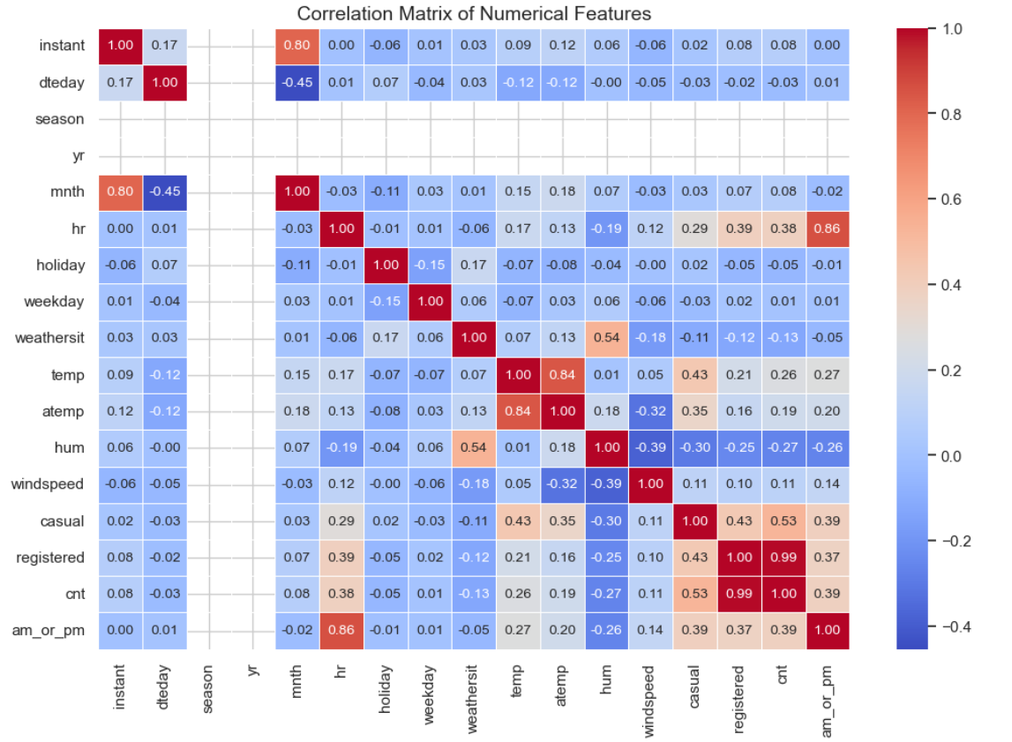
Key Insights
1. Correlation Analysis-
Objective: Understanding relationships between environmental factors and user counts.
Insights: A heatmap of correlations reveals which variables are strongly related to user counts.
Likely findings:
Temperature may positively correlate with user counts (more rides during warmer weather).
Humidity or windspeed might have negative correlations (less favorable conditions for outdoor activities).

Slide 11
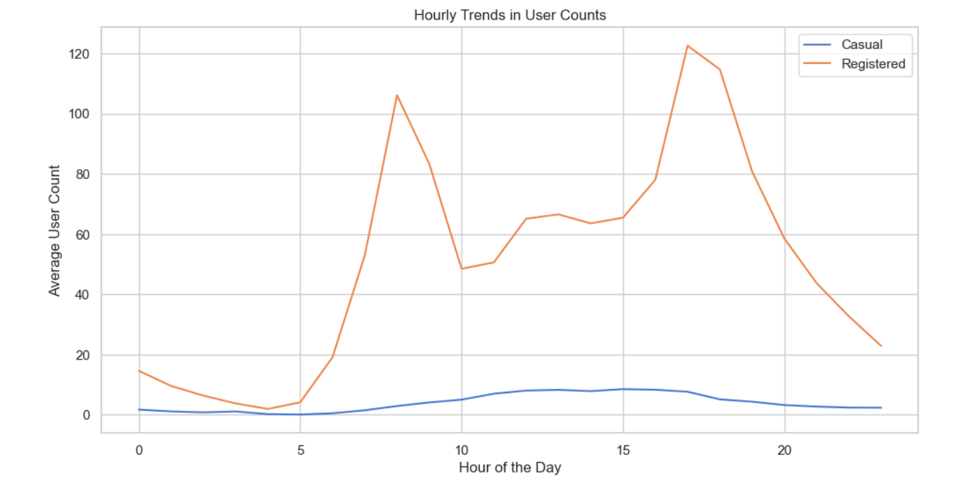
Key Insights
2. Temporal Trends
Objective: Identifying patterns in user counts across time.
Insights:
Hourly Trends:
Peaks likely occur during commuting hours (morning and evening) for registered users.
Casual users may show increased activity during weekends or leisure hours.
Seasonal Trends:
User counts may rise in spring/summer and dip in fall/winter.
Holidays likely show distinct patterns with more casual riders.

Slide 12
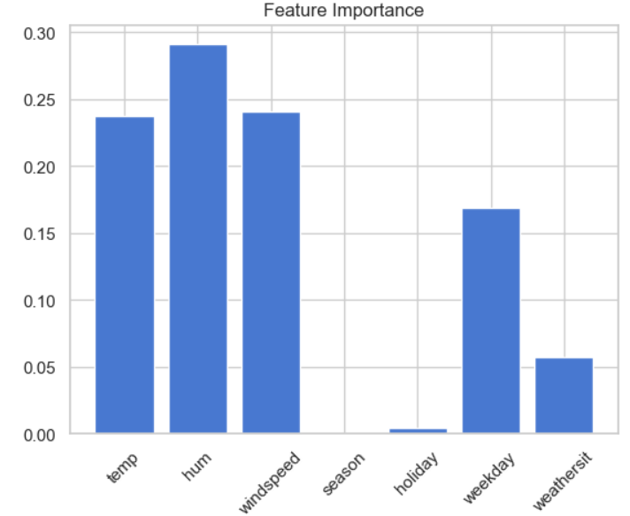
Key Insights
3. Feature Importance Analysis
Objective:
Identifying factors most influencing user behavior.
Insights:
Likely top contributors:
Temperature: Higher temperatures often lead to increased user counts.
Season: Different seasons have distinct patterns of user activity.
Weathersit: Clear or misty weather supports more rides compared to rainy or snowy conditions.
Lesser contributors:
Windspeed and Humidity: These may have smaller but consistent effects on user behavior.

Slide 13
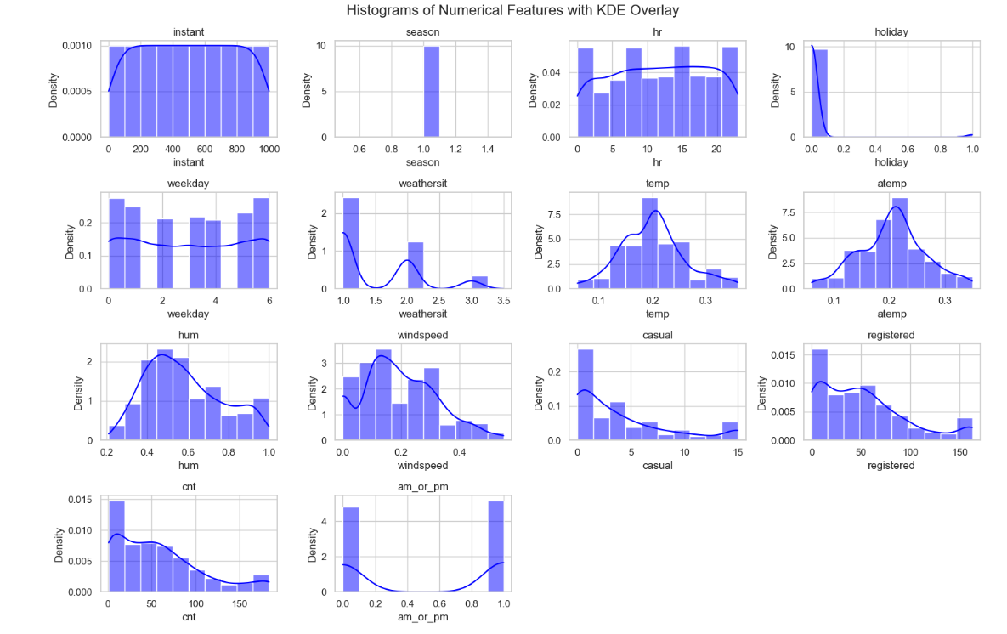
Some Visualizations

Slide 14
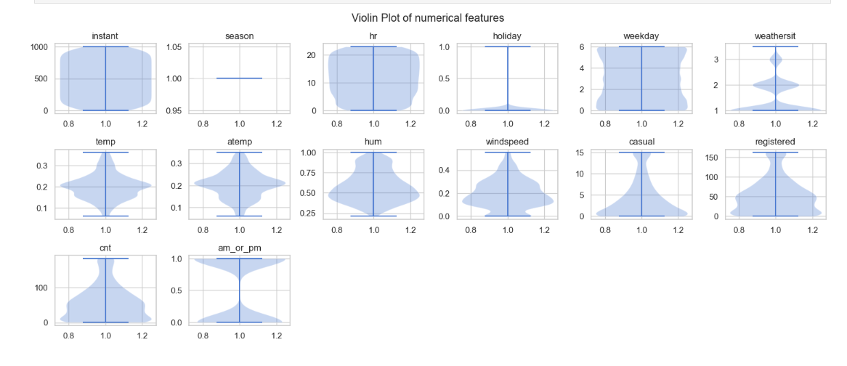

Slide 15
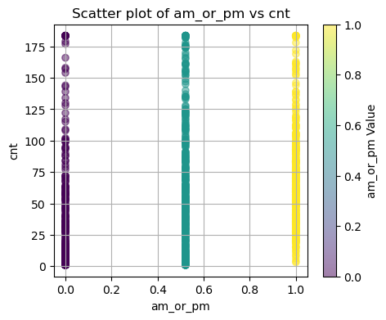
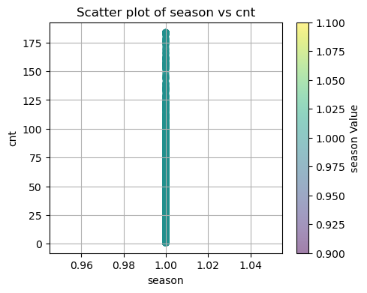
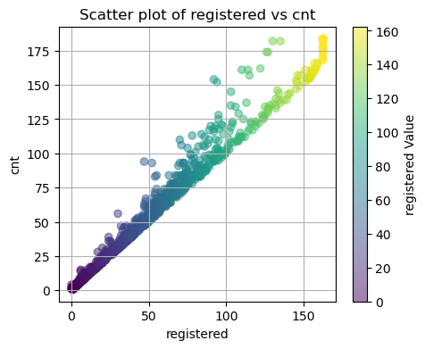
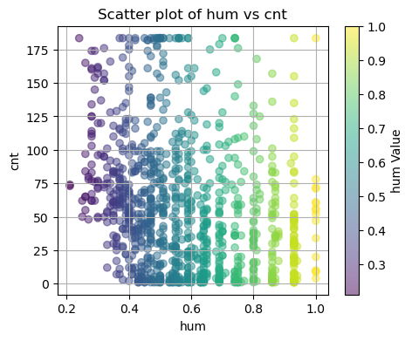
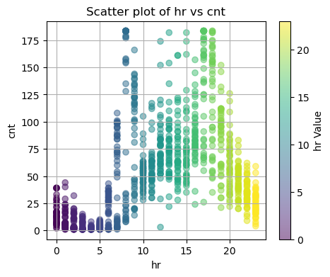
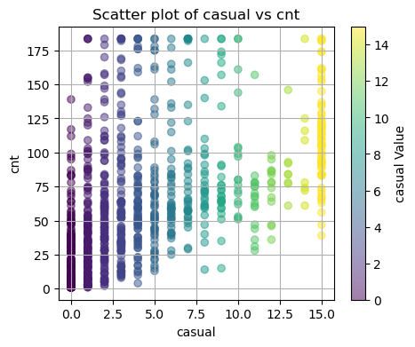
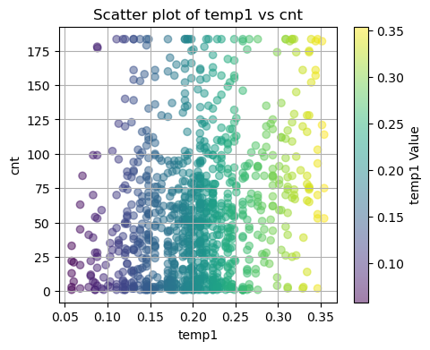
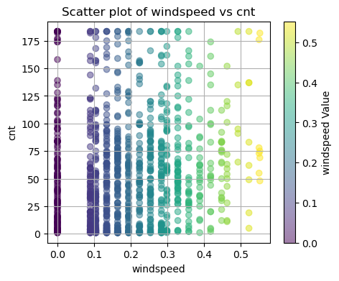

Slide 16
Learning Outcomes
Practical Experience in Data Handling- Gained hands-on skills in dataset cleaning and wrangling techniques. Developed proficiency in managing missing values and outliers.
Exploratory Data Analysis Techniques- Understand and apply various statistical methods for data analysis. Utilize visualizations such as boxplots and heatmaps to derive insights
Preparation for Advanced Modelling- Learn to prepare datasets for subsequent modeling and business applications. Enhancing ability to communicate findings effectively through presentations and documentation.
Github repository- https://github.com/Avantikaverma1402/NextHikes-IT-Solutions-Project-2-Data-Harmonization-and-Insights-Extraction.git

Slide 17
Thank You

